Slide 1
GESTURE CONTROLLED ROBOT USING IMAGE PROCESSING
Mentor :
Vadivelan Murugesan
( ECE III Year )
Members :
Jayaashree.P
Sakthi Priya.S
Shwetha.A
S.Subhashri
( ECE II Year )

Slide 2
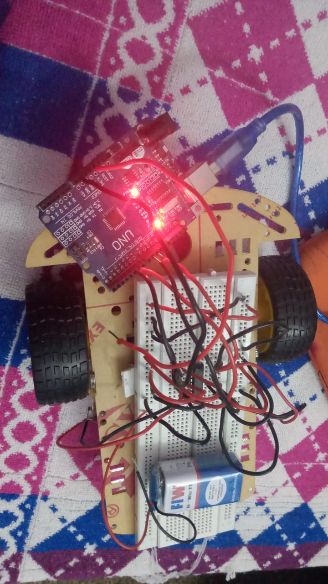
ABSTRACT
This project is a real time monitoring system by which humans interact with robots through gestures. While earlier works have focused primarily on issues such as manipulation and navigation in the environment, few robotic systems are used with user friendly interfaces that possess the ability to control the robot by natural means. Gesture recognition consists of three stages: capturing of image, image processing and navigation of bot. By giving commands to a robot, the user can control or navigate the robot using gestures of his/her palm, thereby interacting with the robotic system.

Slide 3
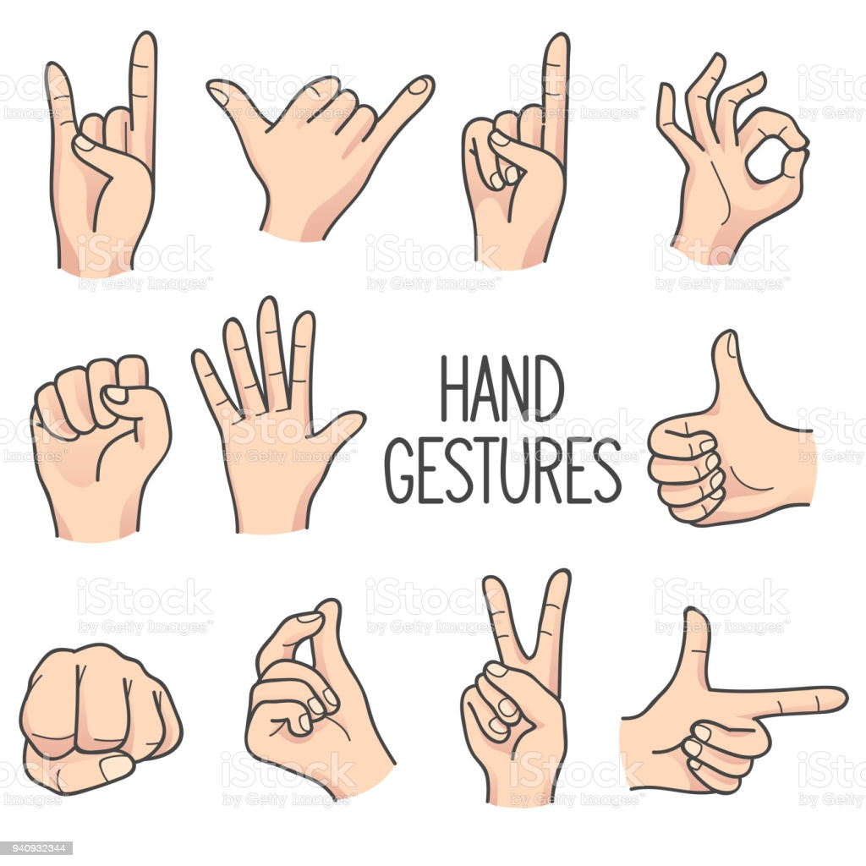
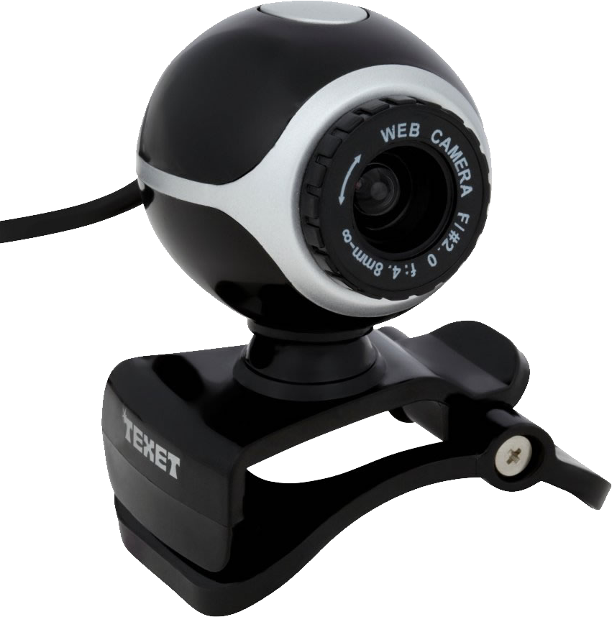

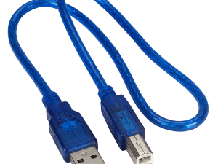
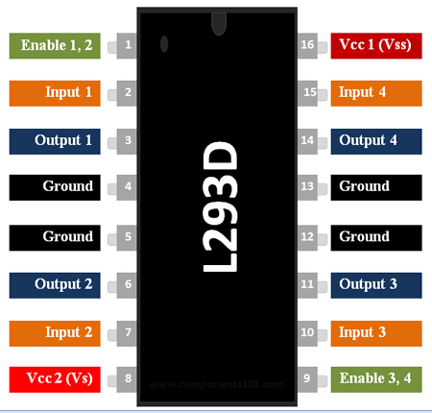
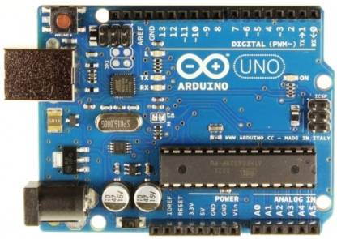
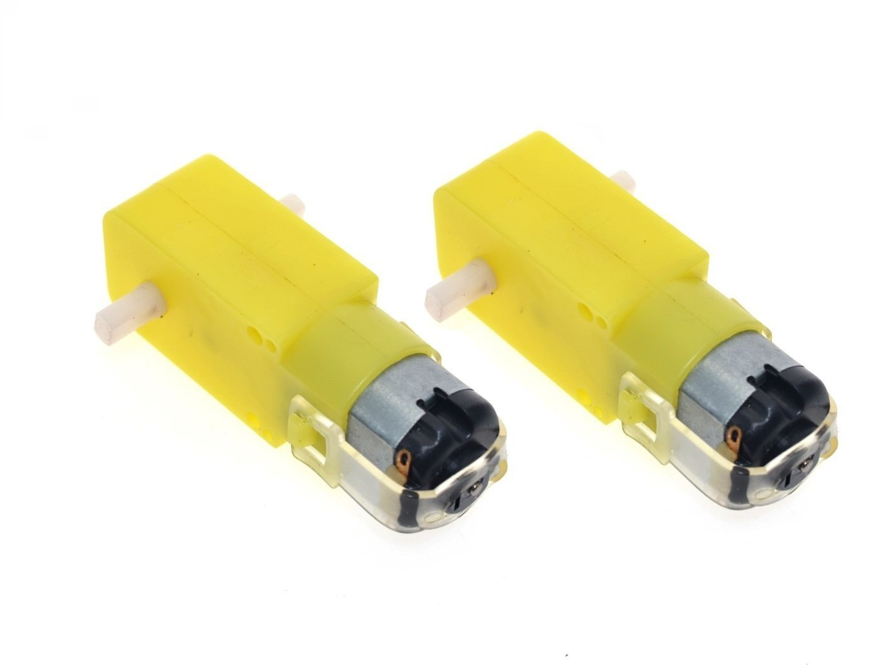
BLOCK DIAGRAM
TRANSMITTER
SERIAL COMMUNICATION
PROCESSING
UNIT
RECEIVER
OUTPUT

Slide 4
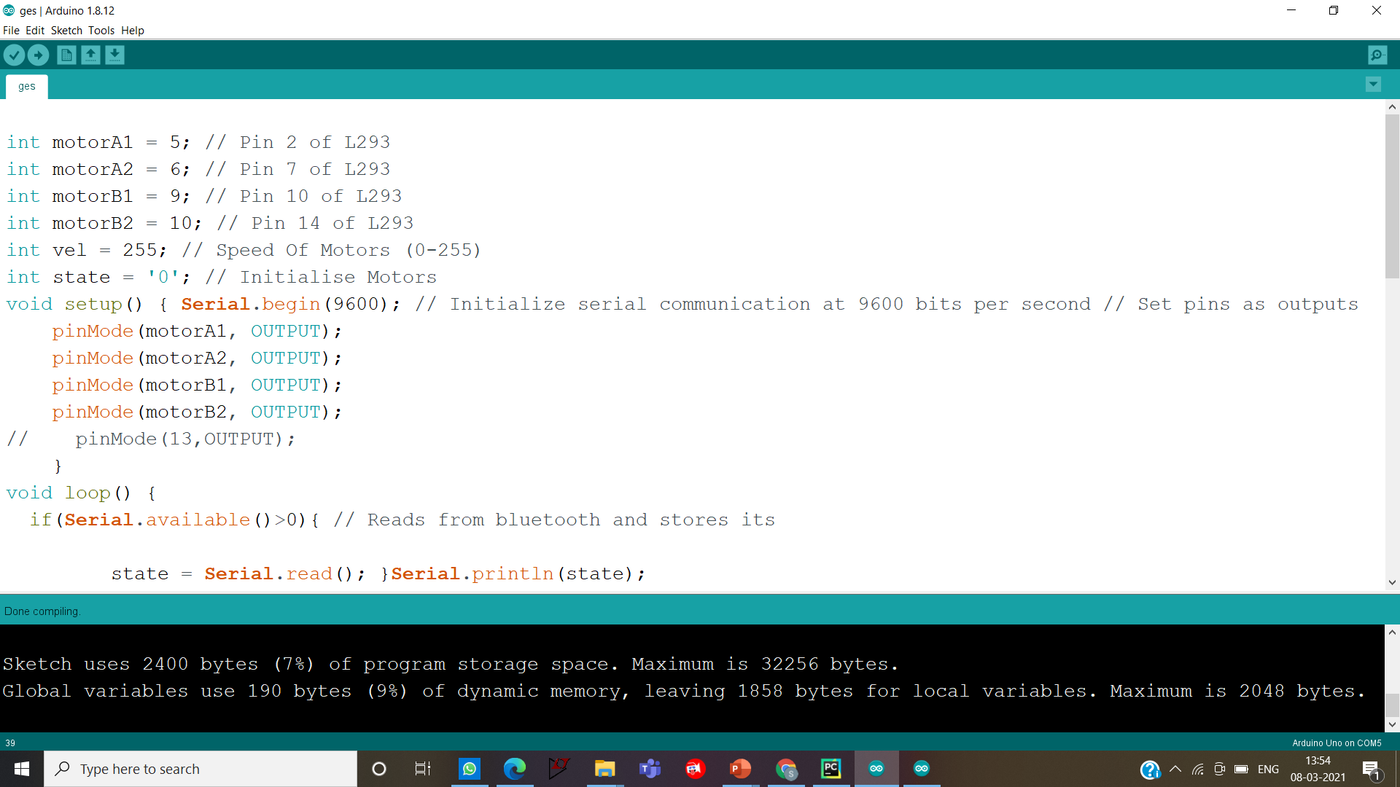
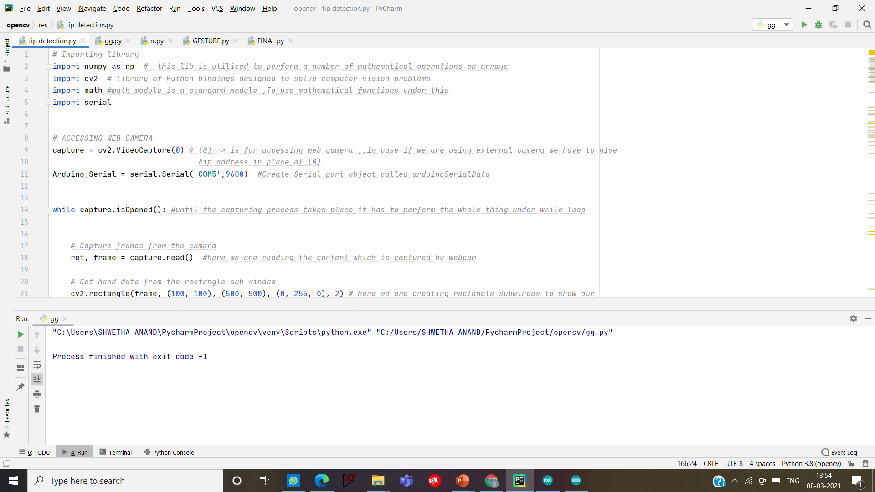
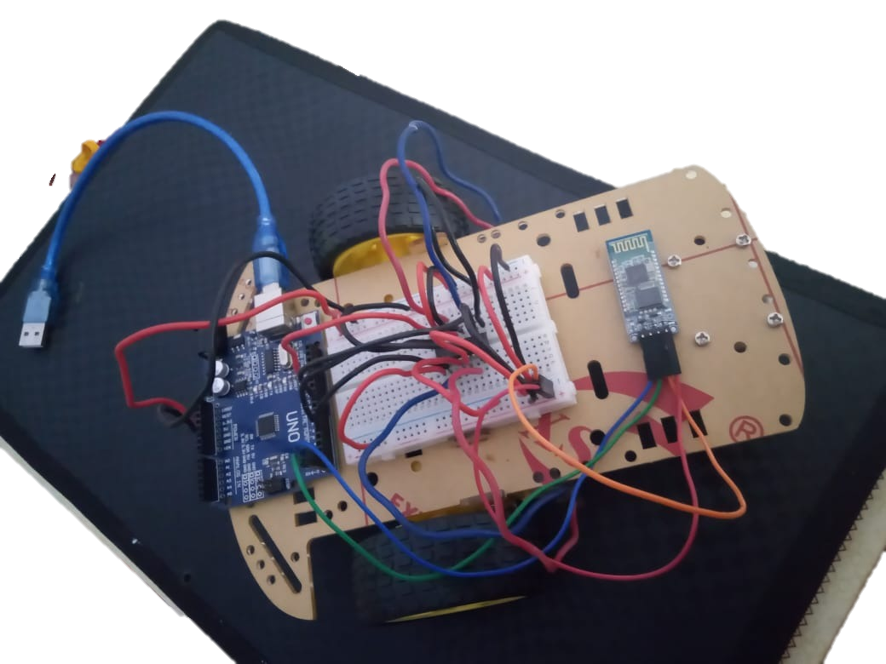
SERIAL COMMUNICATION BETWEEN BOT AND PYTHON
ARDUINO Code Editor
PYCHARM Code Editor
USING PYSERIAL LIBRARY
To communicate with ARDUINO
using PYTHON
Gesture displayed in the screen will be communicated to bot
Using HC06 Bluetooth module
OUTPUT
BOT will navigate accordingly

Slide 5
OUTPUT
GESTURE | DIRECTION OF BOT
ONE | STOP
TWO | REVERSE
THREE | LEFT
FOUR | RIGHT
FIVE | FORWARD

Slide 6
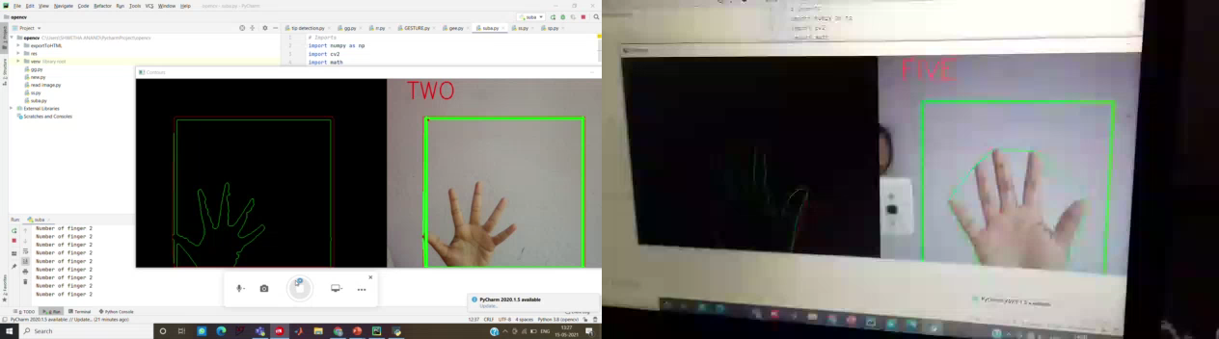

Slide 7
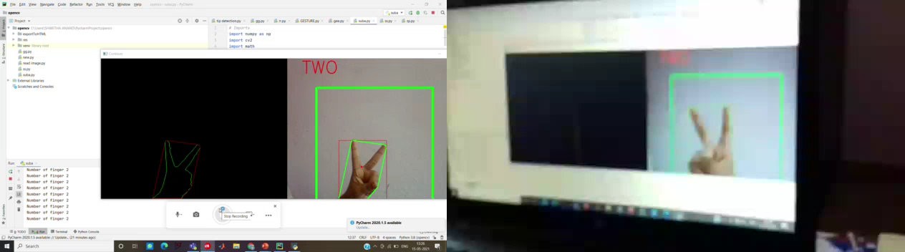

Slide 8
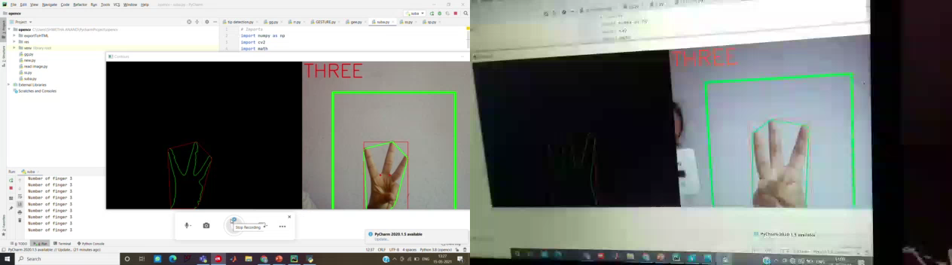

Slide 9
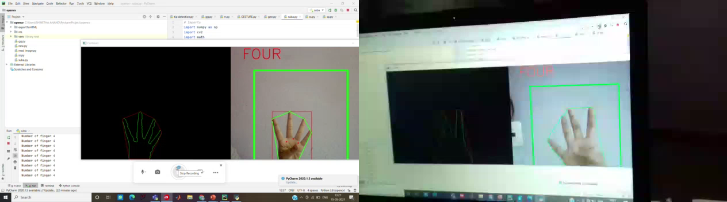

Slide 10
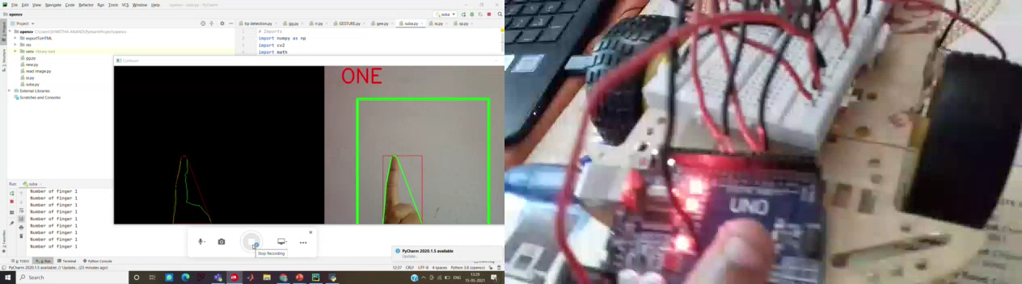

Slide 11
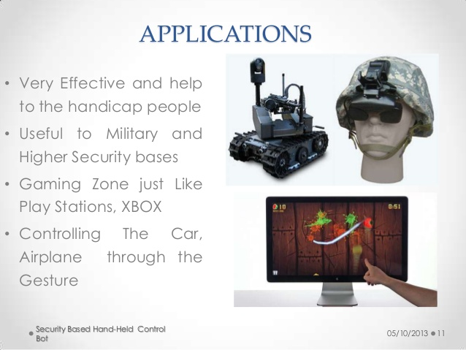



Advantages Disadvantages

Slide 12
THANK YOU!!!

